Slide 1
NHSScotland Community Benefit
Gateway portal

Slide 2

The role of the health system in community wealth building
Anchor institutions are large locally rooted public sector or private organisations that have a major presence and impact on communities in their local area.
This short animation describes the role of NHSScotland anchor institutions in reducing poverty and inequalities, and in building community wealth by keeping more money and resources in the local community. The Community Benefit Gateway supports community wealth building by helping resources (or benefits) from NHSScotland suppliers reach the communities local to them where they are most needed.

Slide 3
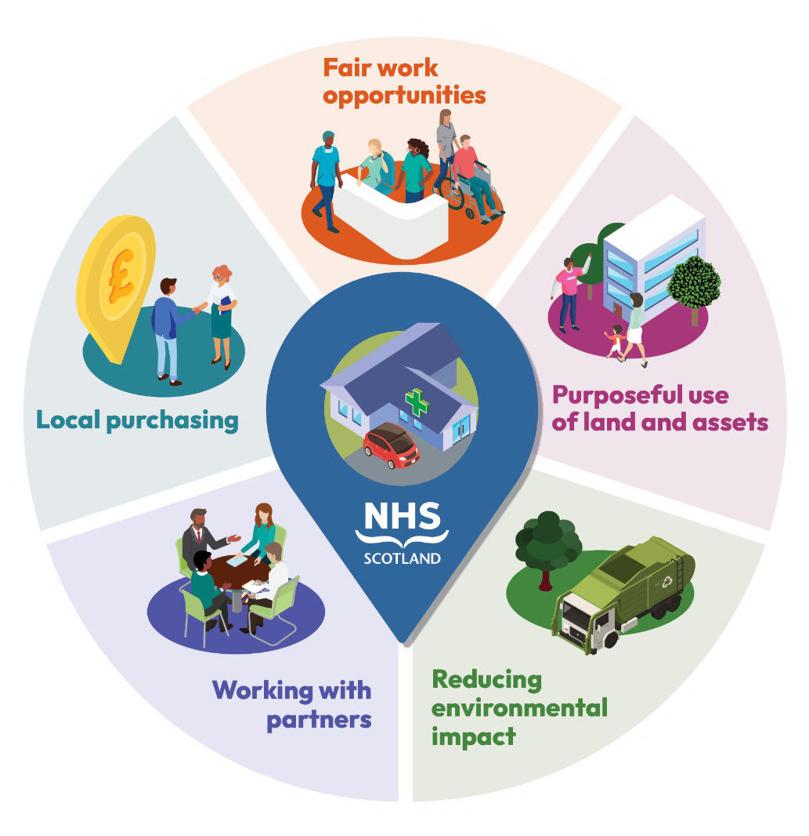
Five key principles of anchors
Anchor institutions can support community wealth building by focusing efforts in the five key areas illustrated in this infographic. These include:
      local purchasing to build local capacity and support local supply chains
      working with partners to maximise innovative solutions while adding wealth and power back into local communities.
      The Community Benefit Gateway can increase the impact of anchor institutions by connecting the real needs in a community with supplier resources.

Slide 4
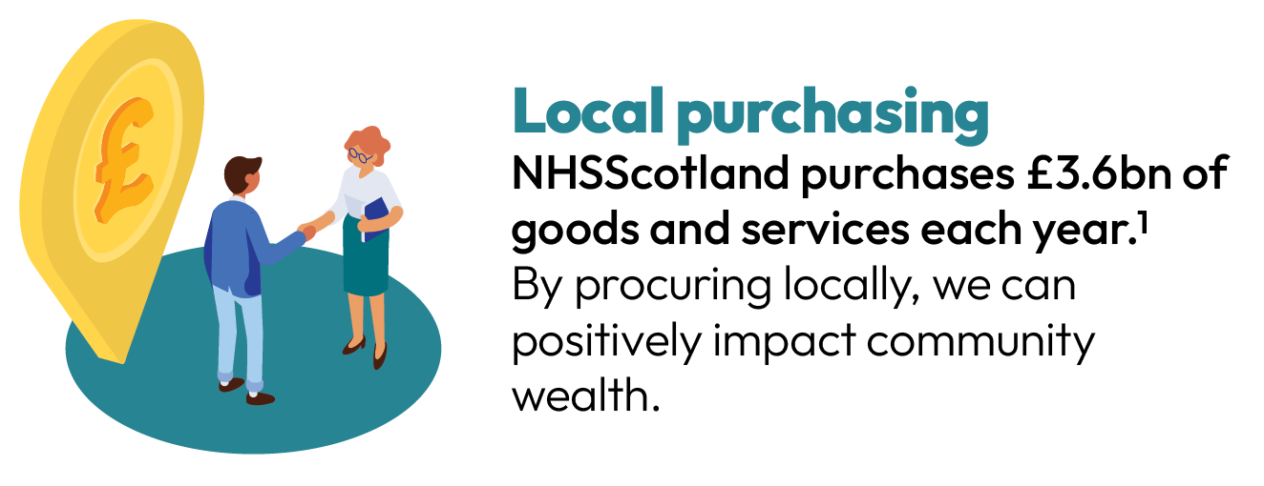
Anchor institutions – local purchasing
By working in partnership with organisations to build and deliver community benefits (and embed fair work practices) into procurement, anchor institutions can have a positive impact on community wealth and wellbeing. This is because of redirecting and more fairly distributing their spending to help strengthen the building blocks of health for those at the highest risk of inequalities.
1 Figure from DXC Technology** data (2022-23) via National Procurement National Services Scotland (NSS.)
**DXC Technology provides data analytics services to support procurement business intelligence.

Slide 5




What are community benefits?
Community benefits are contractual agreements between a public contracting authority and a supplier. When a supplier bids for and wins a contract, it is required to collaborate in some way to deliver some form of resource or support to benefit the society.
In Scotland, the award of public contracts is regulated by the Procurement Reform (Scotland) Act 2014. Within the act, there is the 'Sustainable Procurement Duty' which specifically requires the contracting authority to consider how, in conducting the procurement process, it can improve the following aspects:
 Social  Environmental  Economic growth  Reducing inequalities

Slide 6
What is the Community Benefit Gateway (CBG)?
The CBG is an online platform that connects NHSScotland (NHSS) suppliers with
third-sector organisations, representing the needs of local communities.
The system is designed to enable NHSS suppliers to access a diverse range of initiatives that are listed in the portal so they can provide support.
All of the initiatives listed in the system have been identified as elements that will help to improve the health, social, environmental and economic aspects of local Scottish communities.
The triage and approval process of each of the community needs submitted by
third-sector organisations is done by local NHS public health improvement teams, NHS procurement teams and key local stakeholders.

Slide 7
How does the CBG work?
1. To log in and access the CBG portal, organisations need to complete a registration form.
3. After submission, the local triage group will review the community need for approval. Once approved, the community need will appear on the CBG portal for suppliers to offer support (or ‘bid’ against that need).
4. When a supplier bids against a community need, the third-sector organisation will be notified via email with the supplier’s contact details. Then, the
third-sector organisation will review the bid and should start conversations offline with the supplier to negotiate and agree next steps.
5. After six months, the CBG portal system will automatically generate an email reminder to both parties to update on the outcome of the community benefit. This means the NHSS supplier and the
third-sector organisation will both have an opportunity to describe what’s been happening.
2. Third-sector organisations log in to the portal, where they will complete and submit a ‘community need’ form that collects the details of their request.
To find guides for third-sector organisations and suppliers, visit nss.nhs.scot/procurement-and-logistics/sustainability-information-for-suppliers/access-our-community-benefit-gateway

Slide 8

What are the benefits of the CBG?
Third-sector organisations across Scotland can receive support for their projects.
It supports NHSScotland suppliers to fulfil their statutory duties while being better informed about the (real) needs of local communities.

Slide 9
How can the CBG help you?
The CBG is open to third-sector organisations across Scotland that would like to request support for their projects.
It is important to point out that the CBG is not a funding platform. Therefore, when submitting a community need, please avoid using a direct request or requests for funding and/or financial asks (for example, ‘We would welcome a donation of £X to run our football team’).
When providing information about the type of support your community organisation requires, please try to provide as much detail as possible. For example, if you need equipment for a community garden project – what kind of equipment do you need? For example, trowels, gloves, scissors – and how many of each?

Slide 10




How can the CBG help you? (Continued)
The system has been designed to inform NHSScotland suppliers about the community needs of
third-sector organisations in Scotland.
This results in a wide variety of community benefits that can be delivered. Examples might include (but are not limited to) the following:
Improve community spaces Sponsor community activities Give staff time for volunteering Provide expertise to support local community activities | Provide equipment, products, materials or donations Engage in waste and recycling projects Deliver and support educational activities Offer work experience or job shadowing

Slide 11
Examples of delivered community benefits
Since its launch, the CBG portal has enabled many community benefits to be successfully delivered in different parts of Scotland. Some examples include:
  Mobility equipment
  Volunteers helping regenerate a local green area
  Interview and recruitment skills with unemployed people
  Materials to help run a local women’s charity group
Some of these examples have been further developed into case studies, capturing the impact that the delivery of these community benefits has had in their communities. For more information, please visit: publichealthscotland.scot/our-organisation/procurement/community-benefit-gateway-cbg/case-studies

Slide 12
Online information available
For more information and support materials on the portal, please visit the following websites:
Direct access to the CBG portal
nhsnss.service-now.com/community_benefit
NHSScotland National Procurement Services CBG site
nss.nhs.scot/procurement-and-logistics/sustainability/access-our-community-benefit-gateway
Public Health Scotland CBG site publichealthscotland.scot/our-organisation/procurement/community-benefit-gateway-cbg/overview
Animation for third-sector organisations youtu.be/lCRkGjiqxZU
Animation for NHSScotland suppliers youtu.be/cvO0ZLkqvd4

Slide 13
Further questions and initial queries
If you have any further questions or initial queries, you can email the CBG portal national team inbox directly at tay.communitybenefitgateway@nhs.scot
Translations and other formats are available on request at phs.otherformats@phs.scot or by calling 0131 314 5300.
This publication is licensed for re-use under the Open Government Licence v3.0. For more information, visit publichealthscotland.scot/ogl
1956 5/2025 © Public Health Scotland 2025

