Slide 1

WELCOME….
Richard McIntosh – Fund Development Manager
Contact – tay.nhstcffund@nhs.scot

Slide 2


Slide 3
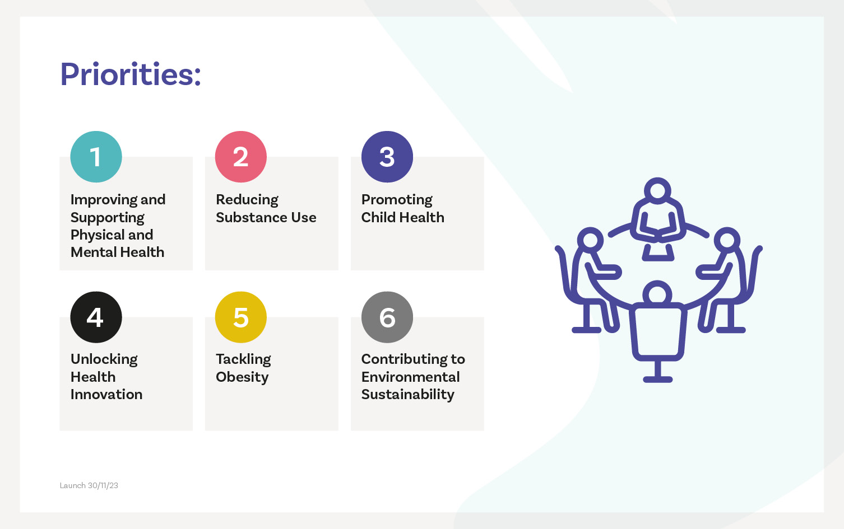

Slide 4
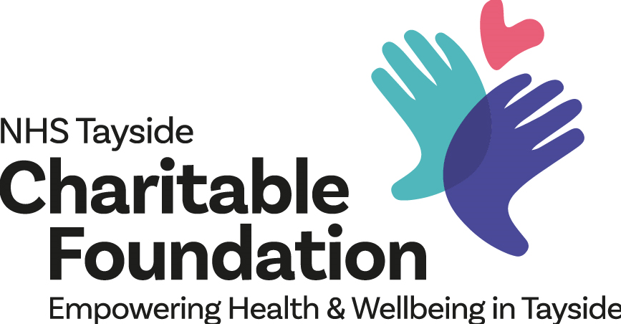
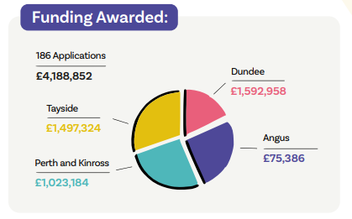
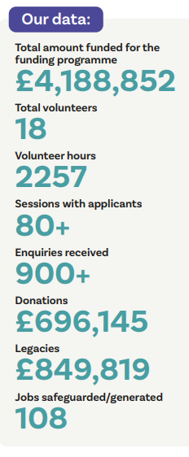
2024/25
*Angus figure doesn’t include £1.7m McKenzie Legacy distributed in 24/25

Slide 5


Charities and social enterprises can apply for up to £150,000 over two years to bring prevention-focused ideas to life.
Charites and social enterprises can apply for up to £25,000 to bring innovation-focused ideas to life.

Slide 6
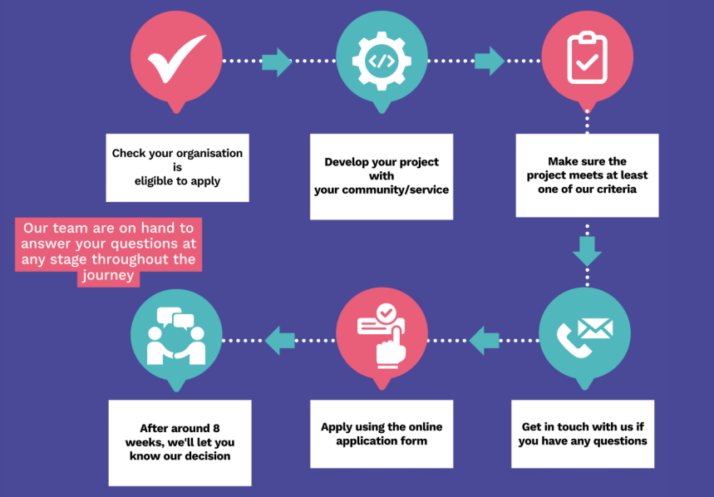

Slide 7



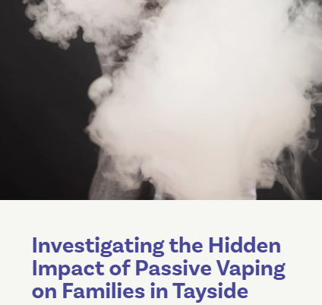

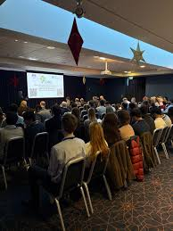

Slide 8
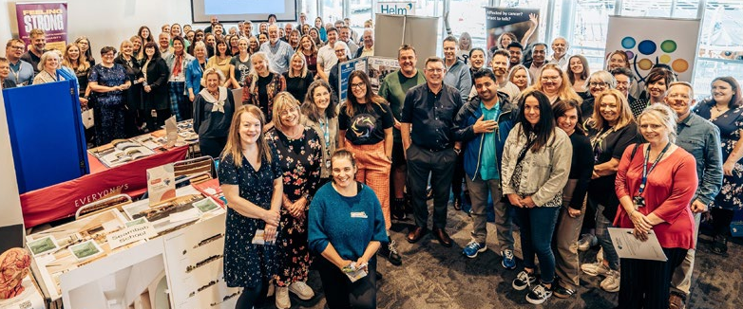
Home - NHS Tayside Charitable Foundation
Apply for Funding - NHS Tayside Charitable Foundation

