Slide 1


Slide 2
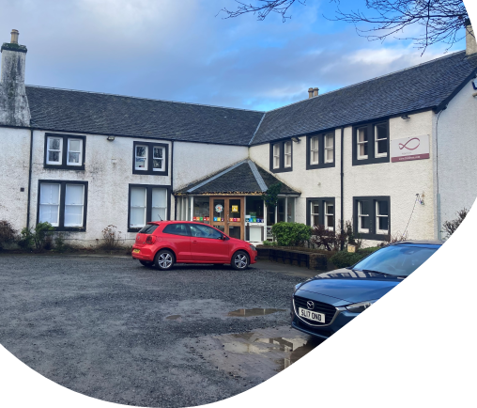

Working across Perth and Kinross
Funding : Support in the Right Direction fund (SiRD)
Established by ‘Outside the Box’
Independent charity since December 2020
Office base in Dunkeld in Community co-working space

Slide 3
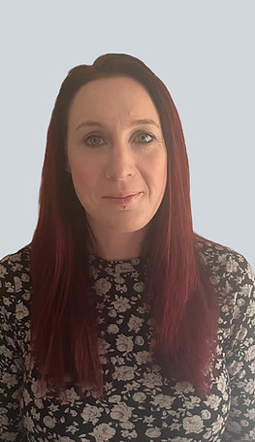
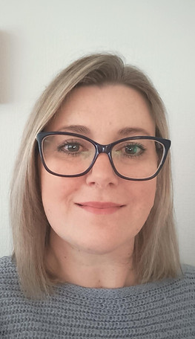
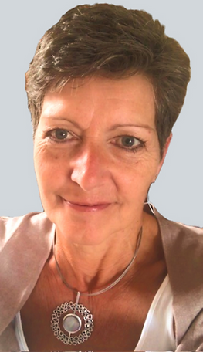
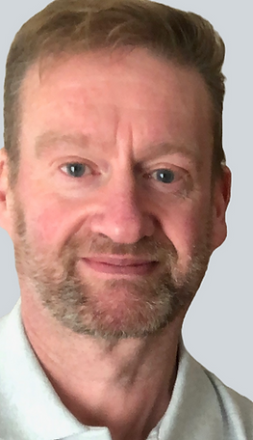
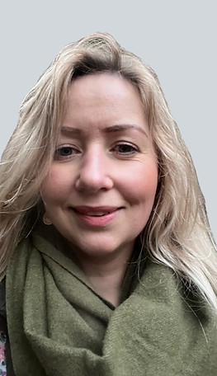
3 Community Workers (Sam, Vivian, Alison)
(Community Brokerage qualified)
Manager (Richard)
Administrator (Vicky)
Board of Trustees

Slide 4
Our principles
Independence – separate from statutory services
Impartiality – not promoting one option over another
Person-centredness – tailored to the individual’s goals
Empowerment – building the person’s confidence and capacity

Slide 5

What we do…….
S – Support to navigate the social care system
U – Understanding your rights and entitlements
P – Promoting and strengthening the Personal Assistant (PA) workforce
P – Person-centred community brokerage
O – Objective, independent information and advice
R – Rights-based expertise in Self-Directed Support (SDS)
T – Tackling inequality and service gaps

Slide 6
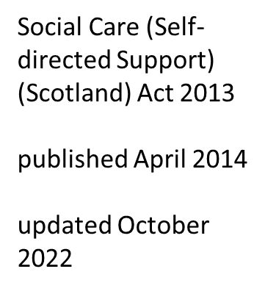
Self Directed Support (SDS) is the way social care is delivered in Scotland
Based on values in action:
COLLABERATION
PARTICPATION
DIGNITY
RESPECT
Notes:
The main principle of SDS is to provide individuals who require social care support with more choice and control over their lives and how their support is delivered.
It's about helping people to live a good life:
- Help to get out & about
- Help to stay safe and well
- Help to do what matters to me
Everyone is entitled to an assessment for social care or SDS: it is available to children, adults and unpaid carers.
SDS is founded in legislation - primarily the Social Care Act 2013 which states:

Slide 7
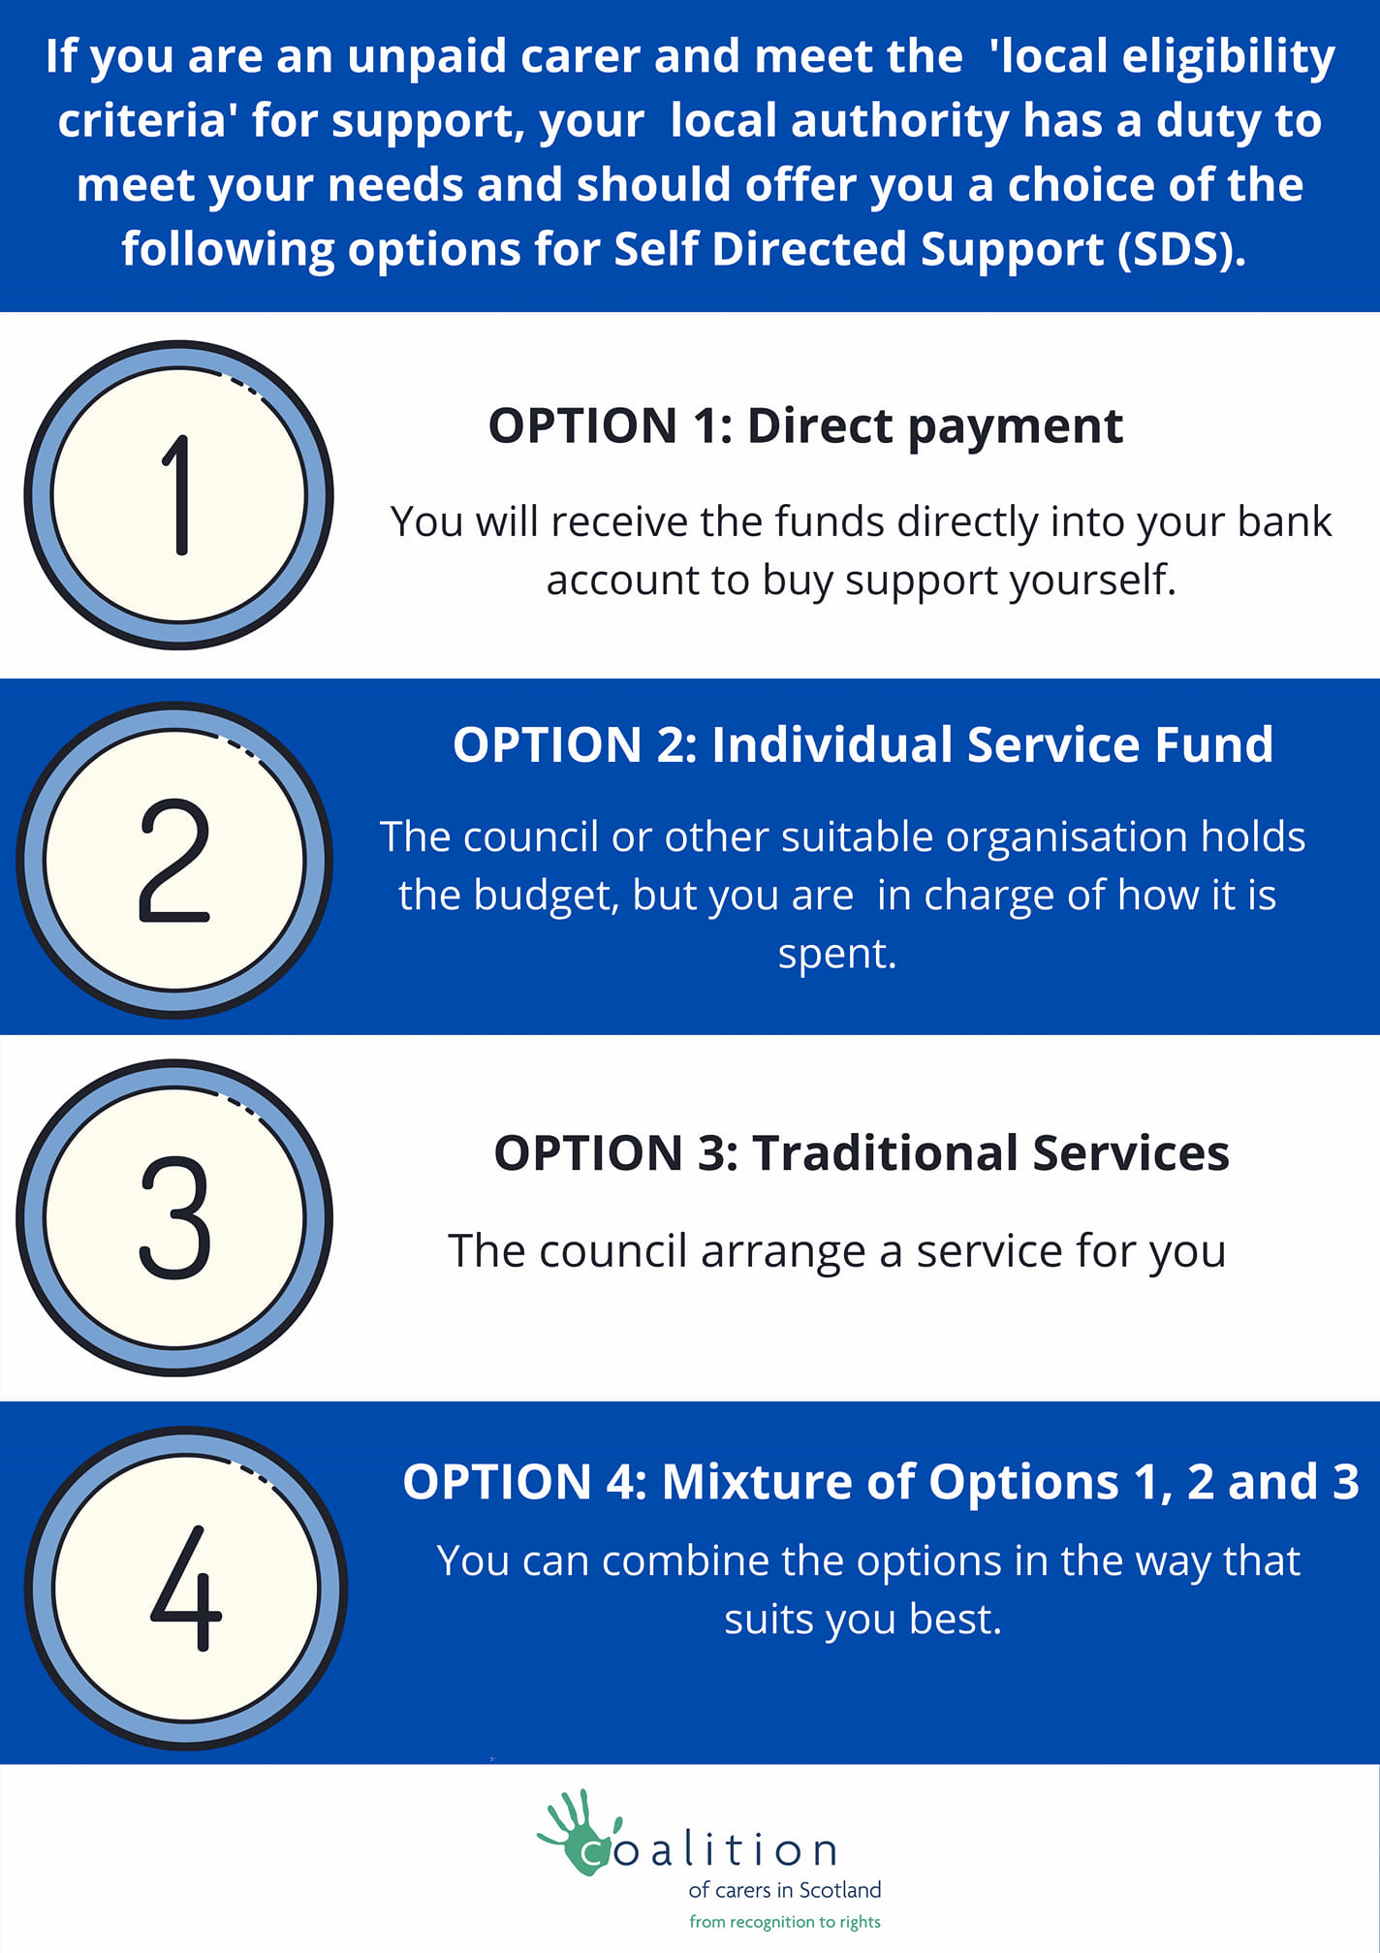

Slide 8
1. Initial Contact & Engagement
The individual contacts Support Choices to explore their needs and understand SDS. Impartial information is provided about SDS options, rights, and processes.
2. Support with Decision-Making
The person is supported to reflect on their goals and choose the SDS option.
3. Support with Assessment & Planning
Help is given with preparing for assessments and contributing to support planning.
4. Advocacy & Representation
Support is offered for meetings, appeals, and ensuring the person's voice is heard.
5. Support with Implementation
Practical help is provided to set up and manage the chosen SDS option.
6. Ongoing Support & Review
Continued assistance is available to review and adapt the support as needed.

Slide 9
Community Brokerage
Community brokerage is about supporting people in their own communities, through early intervention and maximising the use of community resources.
It includes supporting access to social care through any of the SDS options.
It is a way of working which encourages communities and individuals to be resilient and exercise choice and control.
The model of community brokerage was first established in Scotland at the time that Self-directed Support legislation came into effect.

Slide 10
Personal Assistants in Perth and Kinross
The Scottish Government: the minimum rate of pay for Personal Assistants will increase to £12.60 an hour from April 2025.
In Perth and Kinross the rate is £19.17/hr paid to the employer
Developing the PA workforce and recognizing the work they do
Supporting to upskill PA’s through advice and signposting to relevant training
- Training Hub - https://www.cilpk.org.uk/personal-assistants/
Provide ongoing support
Advertising on behalf of families – Linking to PA’s

Slide 11

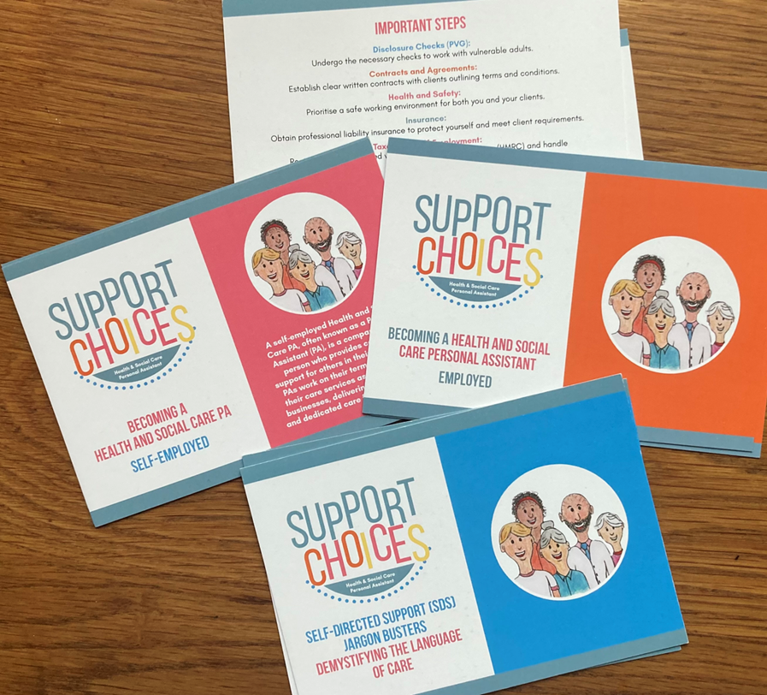


Our biggest challenges
Personal Assistants
SDS knowledge
Lack of services AND COMMUNITY RESOURCES

Slide 12
2024 statistics

Slide 13
www.supportchoices.co.uk
01350 729130
info@supportchoices.co.uk

