Slide 1



Information Pack
Facial Palsy UK 2023
Facial Palsy UK (A Company Limited by Guarantee) Charity registered in England & Wales (1148115) and Scotland (SC045086). Company number 08107184

Slide 2
What is Facial Palsy?
Facial palsy generally refers to weakness of the facial muscles, mainly resulting from temporary or permanent damage to the facial nerve.
When a facial nerve is either non-functioning or missing, the muscles in the face do not receive the necessary signals in order to function properly. This results in paralysis of the affected part of the face.
There are different degrees of facial paralysis: sometimes only the lower half of the face is affected, sometimes one whole side of the face is affected and in some cases both sides are affected.

Slide 3
What causes facial palsy?
There are more than 50 different causes of facial palsy including:
Bell’s palsy – the most common
Ramsay Hunt syndrome – a complication of shingles.
Tumours – either when they grow or when surgically removed.
Neurological conditions
Trauma - such as fractures to the brain, skull or face.
Stroke – where messages aren’t received from the brain as opposed to facial nerve injury.

Slide 4
What causes facial palsy?
It can also be present at birth as a result of:
Birth trauma, for example caused by forceps or facial presentation delivery.
Congenital conditions such as an abnormal development of the facial nerve or muscle in the womb.
Rare genetic syndromes such as Moebius syndrome or CHARGE syndrome.
There are many more causes than listed here.

Slide 5
How does facial palsy affect people?
There are many different physical symptoms that can be associated with facial palsy such as problems with:
Smiling
Eating & drinking
Speaking
Blinking the eye(s) or closing eye(s) for sleep
Pain (in the face and/or eye(s))
Unwanted linked movements called synkinesis

Slide 6
How does facial palsy affect people?
It can also be difficult psychologically:
Affects the ability to communicate in the expected way.
Dating and personal relationships, e.g. can be difficult to kiss.
School life – as children can be bullied.
People with facial palsy can have low self-esteem.
Many people suffer with anxiety and/or depression.
People often dislike being in photos or video.

Slide 7
When weak muscles become strong
When facial palsy begins the muscles are weak because they are not receiving messages from the facial nerve.
As recovery takes place, the muscles can become short, tight and painful. This is called synkinesis, the muscles have now become too strong.
Synkinesis can also cause linked movements such as when the person smiles their eye closes.
Synkinesis can be improved with specialist facial therapy and Botox injections, but many GPs are unaware help is available.

Slide 8
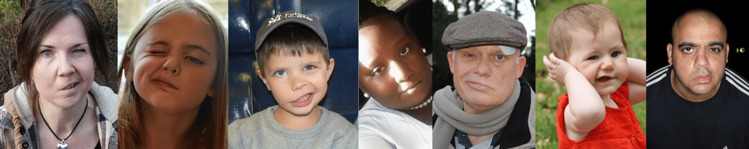
Who can get facial palsy?
Facial palsy can affect anyone of any age, at any time in their life. We all have a one in 60 lifetime chance of developing the most common cause of facial palsy – Bell’s palsy.
100,000 people are estimated to have facial palsy in the UK.

Slide 9
Facial Palsy facts and figures*
In a 2019 survey the top five psychological issues reported were:
Self-consciousness
Low self-esteem
Grief
Anxiety
Depression
*Based on a Facial Palsy UK survey of 421 respondents in 2019.

Slide 10
Facial Palsy facts and figures*
All respondents were asked what could improve their quality of life with reference to facial palsy?
  Routine access to health care for people with facial palsy (84.1%)
  More psychological support for people with facial palsy (83.8%)
  More awareness of facial palsy among the general public to improve attitudes and understanding (81%)
*Based on a survey of 421 respondents in 2019.

Slide 11
Many people who don’t fully recover from facial palsy in the first few weeks are left to get on with it.
The NHS has very little information on its website about facial palsy.
Many doctors do not know where to refer patients to for help.
Specialist facial therapy is a postgraduate specialism so many physiotherapists and speech and language therapists do not know how to treat disorders of the facial nerve.
There is very little research being done and treatments are often denied due to lack of evidence for their use.

Slide 12
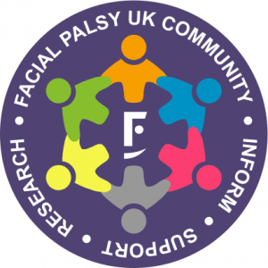
About Facial Palsy UK
Facial Palsy UK is a national charity for anyone affected by facial palsy, whatever the cause.
Our mission
Facial Palsy UK’s mission is for every person in the UK affected by facial palsy to be given access to the best information, treatment and support available.

Slide 13
About Facial Palsy UK
Our aims
Facial Palsy UK pledges:
• To increase awareness of facial palsy and its social, physical and psychological consequences.
• To improve the physical and emotional health of adults and children with facial palsy
• To promote diagnosis, acute and long-term management and rehabilitation of people living with facial palsy.

Slide 14
About Facial Palsy UK
What we do
• Provide information and support for people living with facial palsy, their relatives, carers and medical professionals.
Run local and virtual support groups throughout the UK.
Organise family days for children affected by the condition.
Raise funds to support research and training for professionals involved in the diagnosis, management and treatment of facial palsy.
Publicise the effects of facial palsy and the need for greater services.

Slide 15
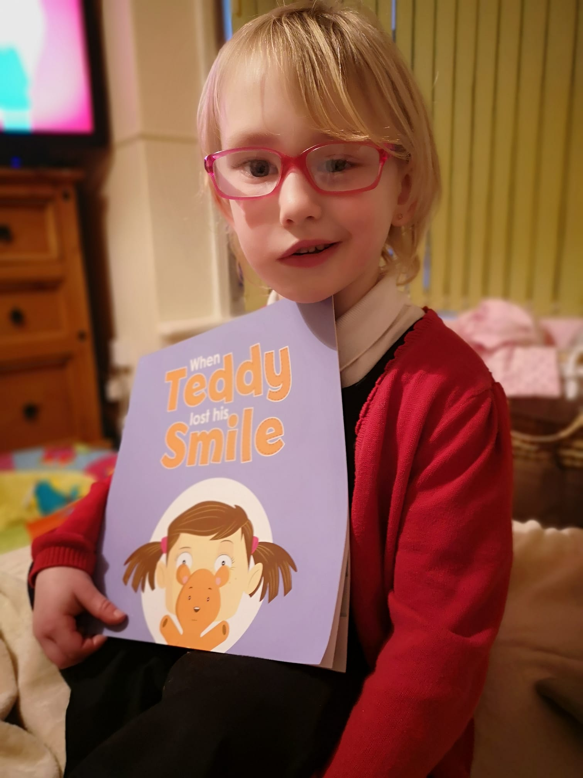
About Facial Palsy UK
What we do
We also have a children’s book called ‘When Teddy lost his smile’ which raises awareness and helps children with facial palsy talk about their own experiences.
This is available to purchase via Amazon.

Slide 16
Facial Palsy Awareness Week
Facial Palsy Awareness Week runs from 1-7 March every year. You can help by following us on social media and sharing our posts. Find us on:
Twitter - @facialpalsyuk
Instagram - @facialpalsyuk
Facebook - /facialpalsyuk
TikTok - @facialpalsyuk
LinkedIn –
https://www.linkedin.com/company/facial-palsy-uk

Slide 17

Please donate to Facial Palsy UK.
Your gift can create a brighter future for those affected by facial palsy.
https://www.facialpalsy.org.uk/donate
Facial Palsy UK (A Company Limited by Guarantee) Charity registered in England & Wales (1148115) and Scotland (SC045086). Company number 08107184.

